Slide 1
AE Cloud2 Arduino Light Sensor SPI (Use Arduino Header)
By Michael Li

Slide 2
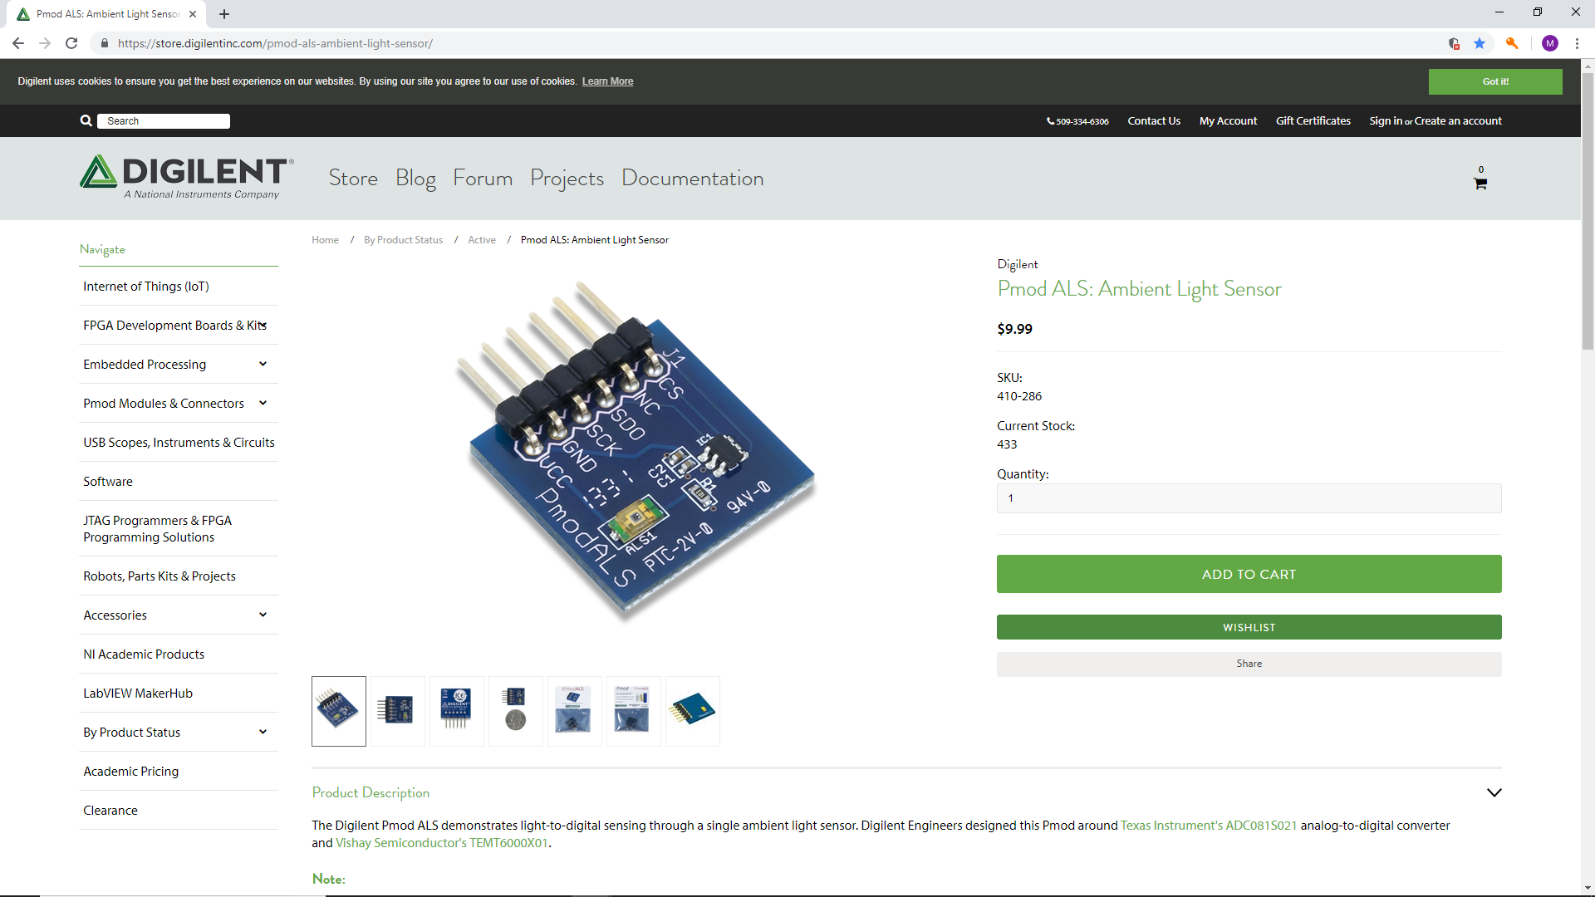
https://store.digilentinc.com/pmod-als-ambient-light-sensor/

Slide 3
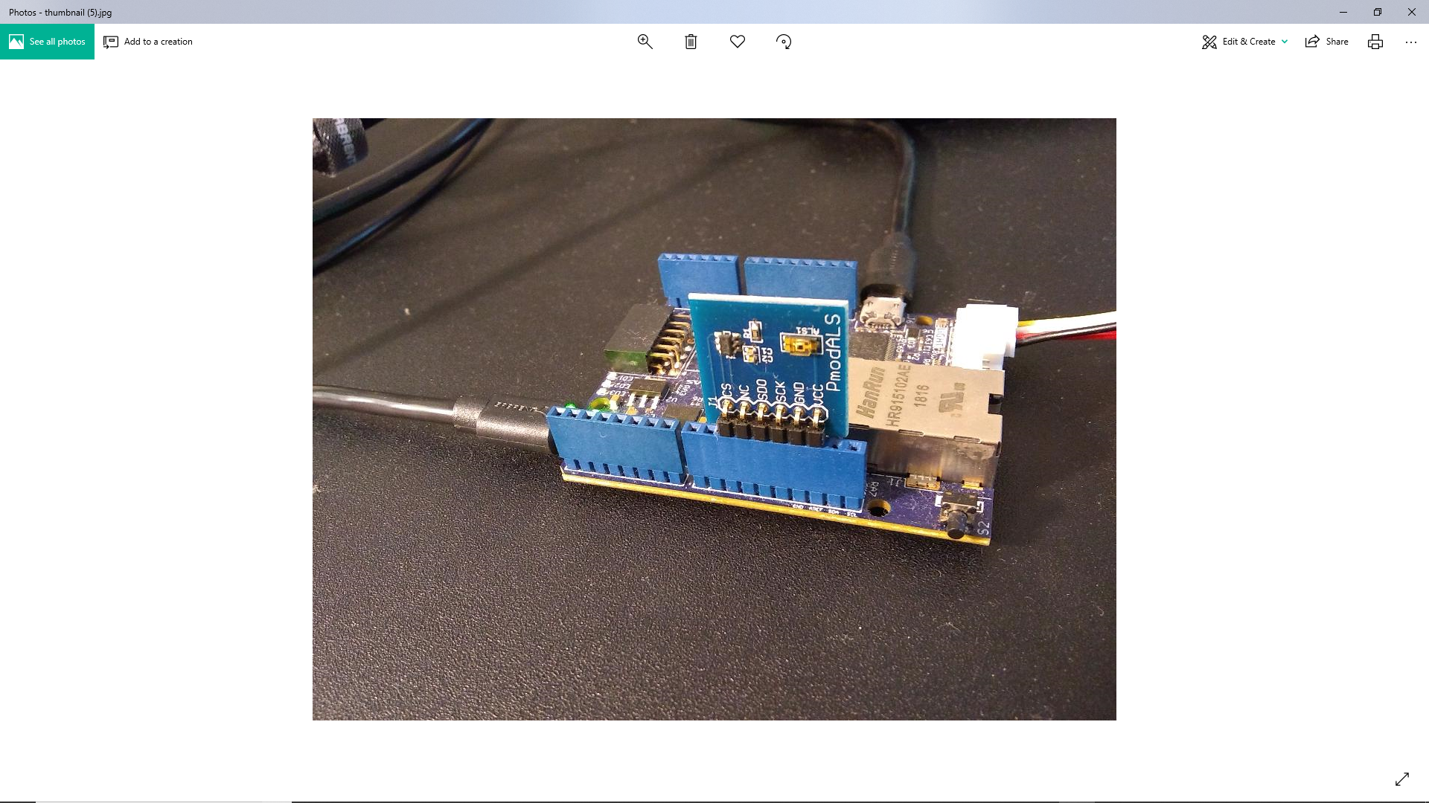
SPI Sensor inserted into the Arduino header

Slide 4
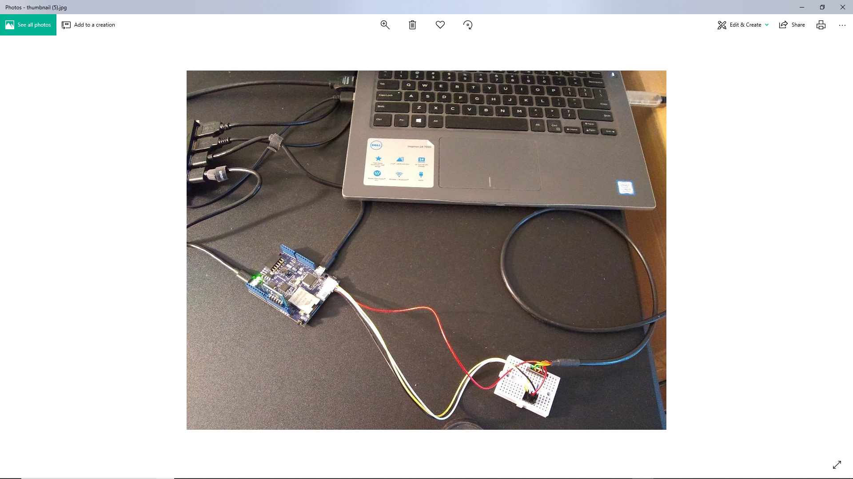
The complete setup

Slide 5
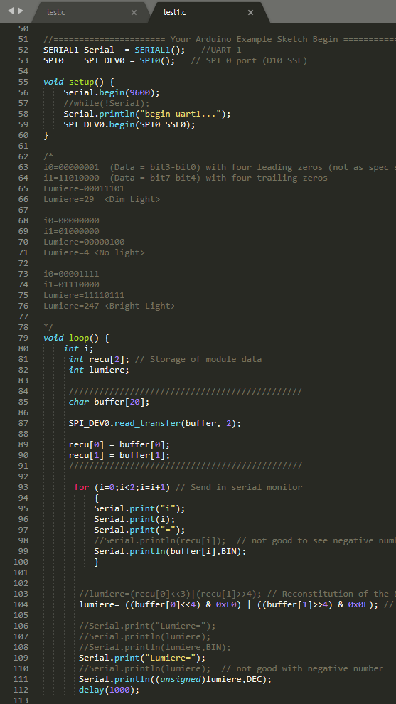
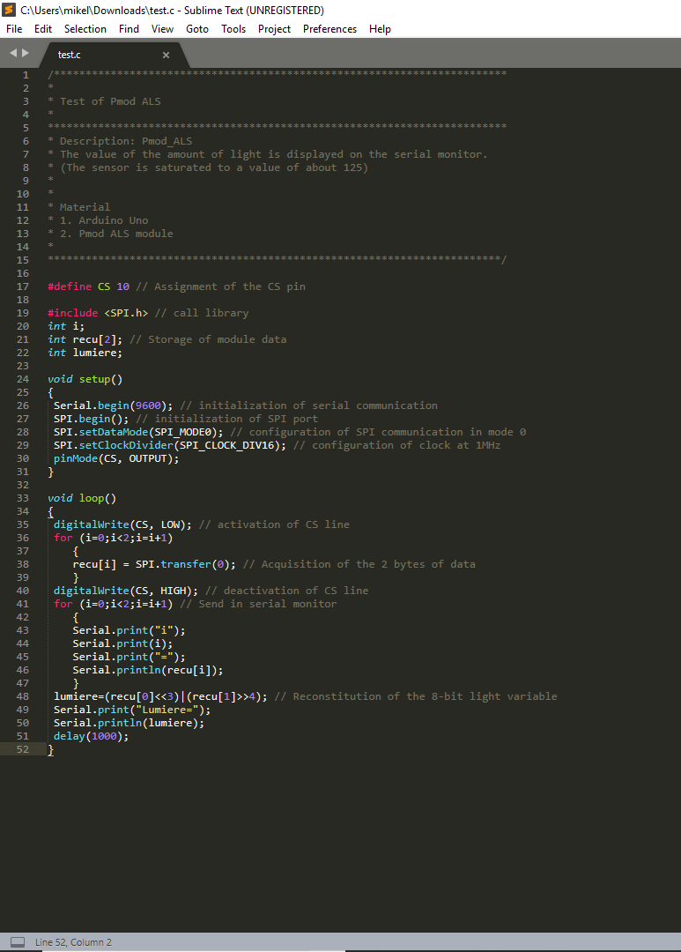
https://www.hackster.io/58085/using-the-pmod-als-with-arduino-uno-e86dca
Working Code in my git repos
Need to instantiate SPI class.
Example Code from Digilent
Default
SPI mode 0
10Mhz clock speed.
CS pin is defined in SPI.h
Modified to run on AE Cloud2
Use read_transfer function
Not correct according to datasheet
This is the correct way to extract the sensor’s data.
Mistake in extracting the light sensor data

Slide 6
My SPI Library
Difference between my SPI library and Arduino Library.
My SPI library (Mod0, CS pin*, Clock Frequency are fixed).
Separate write and read transfer functions. Only read transfer function is implemented at this point.
Note: CS pin are defined in SPI.h header file. Two possible CS pins can be chosen. If the developer wants to use other pin, it can be changed in SPI.h/cpp file but it would require pin configuration change.

Slide 7
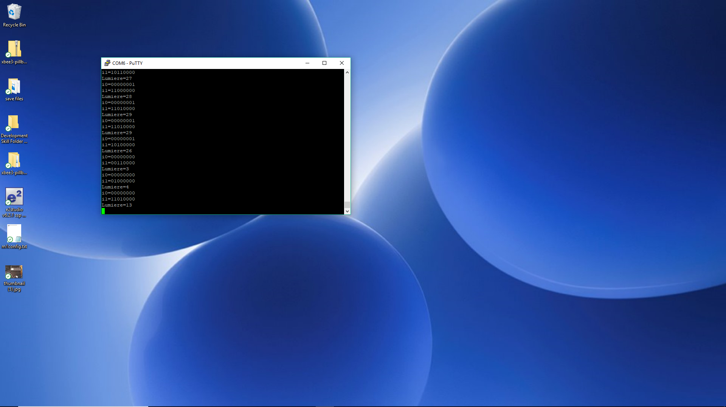
Output.

